Slide 1
Guide on measurement code
Guang Yue
Last change: 4/25/2022

Slide 2
RT RF circuit
I
AWG 1
I
Q
Q
RF
Drive
LO
LO 1
IN
Q
Spectrum Analyzer
Device
DR
AWG 2
I
Q
I
RF
Readout
LO
Out
LO 2
Digitizer
LO
IF
RF

Slide 3
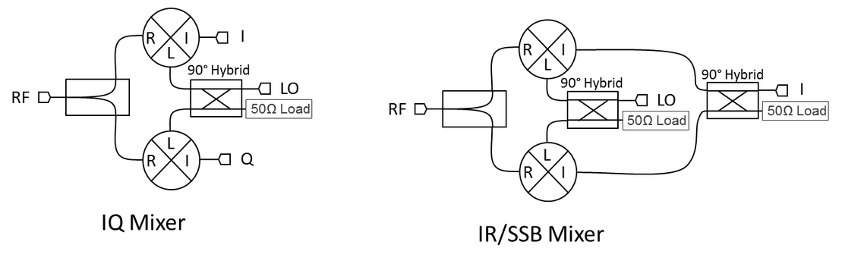
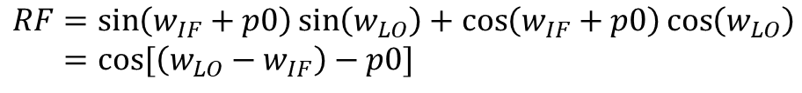
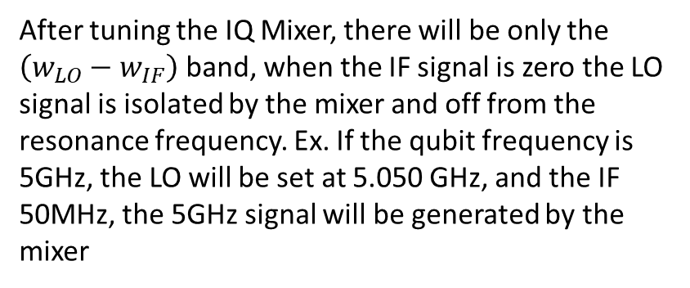
IQ mixer and IR mixer
$$RF=\sin\left(w_{IF}+p0\right)\sin\left(w_{LO}\right)+\cos\left(w_{IF}+p0\right)\cos\left(w_{LO}\right) \\ =cos⁡[\left(w_{LO}−w_{IF}\right)−p0]$$
After tuning the IQ Mixer, there will be only the $\left(w_{LO}−w_{IF}\right)$ band, when the IF signal is zero the LO signal is isolated by the mixer and off from the resonance frequency. Ex. If the qubit frequency is 5GHz, the LO will be set at 5.050 GHz, and the IF 50MHz, the 5GHz signal will be generated by the mixer

Slide 4
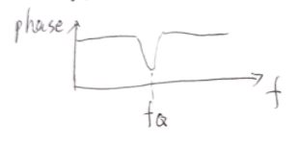
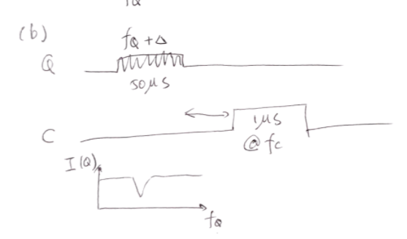
Step 1 Find cavity resonance frequency by VNA
Step 2 Find rough qubit resonance frequency by VNA. Let VNA measure S21 at cavity frequency, same time sweep the LO frequency. when qubit frequency couple to the cavity the reading of VNA will change
Step 3 Spectroscopy measurement to find the precise qubit resonance. Apply qubit resonance pulse, followed by the readout pulse. Scan the LO frequency to find the qubit resonance frequency.

Slide 5
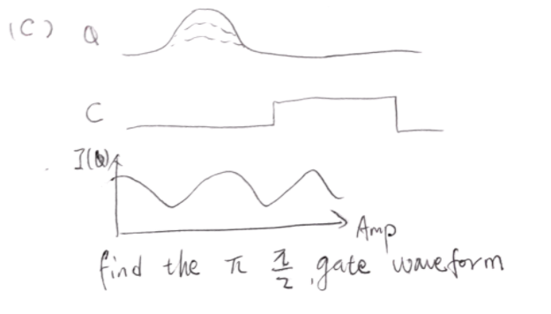
Step 4 Find the Pi or Pi/2 pulse. Drive the qubit at the resonance frequency (Q) and vary the gaussian wave packet height. The readout signal (C) should oscillate with the “pulse length”, then the Pi pulse or Pi/2 pulse can be tuned.

Slide 6
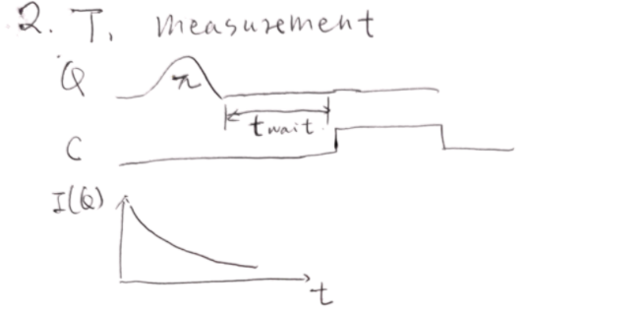
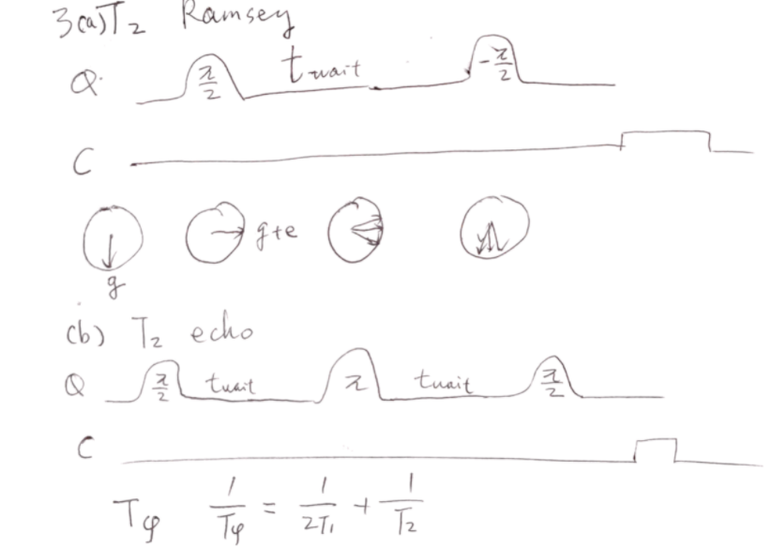
Step 5 Use the tune pulses to drive the qubit to find the T1 T2 time.

